Slide 1
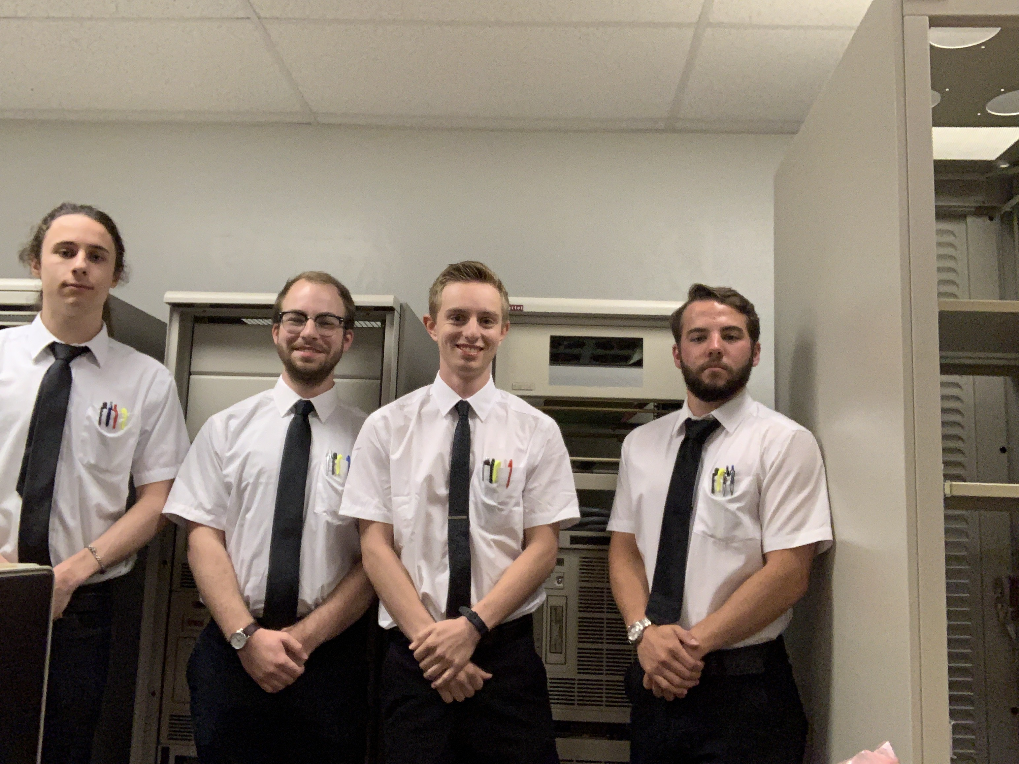
Nasa mission control: day4
Squad leaders: Chance
Co-pilots: zach

Slide 2

URL: KAHOOT.IT
Notes:
Day 4 Review Quiz

Slide 3
Data structures
We will be learning about two general data structures in Python
Array – A structure used to store multiple values in one single variable
Ex: cars = [‘Ford’, ‘Nissan’, ‘Subaru’, ‘Kia’]
Dictionary – A structure used to store multiple values in key-value pairs
car = {‘brand’: ‘ford’, ‘model’: ‘fusion’, ‘miles’: ’20,000’, ‘owner’: ‘Chance’}
Spelling is important in both cases… if we do not properly spell the array name, dictionary name, or dictionary key we will not be able to access the value that we want to

Slide 4
Data structures continued
Values in an array are ‘Indexed’
This means that the items in the array are numbered in order for us to be able to access them easier
The numbering in most programming languages starts at 0
This is a weird concept, and it has just stuck around for a very long time
To access specific values in an array we can use the following format:
Array_name[indexOfDesiredItem]

Slide 5
Some more about arrays
Say we have the following array
cars = [‘Ford’, ‘Volvo’, ‘BMW’]
To access the first item in the array we would use the following code
cars[0]
This would return ‘Ford’ to the programmer
We can also call the ‘len()’ function and insert the name of an array into the parentheses and we get back the size of the array itself
Ex: len(cars) -> this would return the value 3

Slide 6
Some useful array methods
ARRAYNAME.append(“item”) – appends the item in parentheses to the end of the array
len() – we already saw this but it will tell us the size of the array
ARRAYNAME.clear() – will remove all items from the array

Slide 7
Dictionaries
Unlike arrays, we do no access dictionaries by index, instead we use the key to access the value associated with it
Dictionaries are written with {} – curly braces
To access specific values in a dictionary, we can use the following format:
DICTIONARYNAME[key] -> returns the value associated with the provided key

Slide 8
Dictionaries continued
Let look at the following dictionary
myCar = {
“brand”: “Subaru”,
“year”: 2008,
“model”: “Outback”
}
If we wanted to know the model of my car we could get this data with the following code:
myCar[“model”] -> will return “Outback”

Slide 9
Useful dictionary methods
len() – will give us the size of the dictionary if we insert a dictionary name into the parentheses
DictionaryName.clear() – will remove all items from the desired dictionary
Adding to a dictionary use the following format:
DictionaryName[newKey] = newValues

Slide 10
URL: KAHOOT.IT
Notes:
Day 4 Arrays/Dictionaries

Slide 11
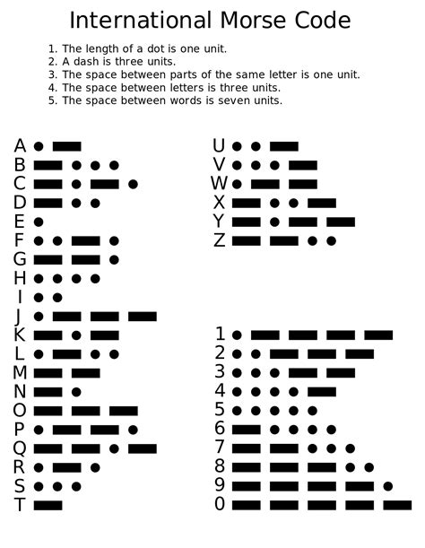
Morse code
IN YOUR GROUPS, TELL EACH OTHER YOUR FAVORITE COLOR IN MORSE CODE.

Slide 12
Using sftp to get base code AND LIBRARY
OPEN A COMMAND TERMINAL
sftp MY_PI’S_IP_ADDRESS
“raspberry”
cd /home/pi/Documents
get MorseCode_Skeleton /home/pi/Documents/Week1_AM_YOUR_TEAM
get MorseCode_Library /home/pi/Documents/Week1_AM_YOUR_TEAM
exit
cd /home/pi/Documents/Week1_AM_YOUR_TEAM
idle MorseCode_Skeleton

Slide 13
Python library
OPEN THE LIBRARY
Idle MorseCode_Library
THIS PYTHON LIBRARY TANSLATES ENGLISH INTO MORSE CODE
THE LIBRARY ALSO DEFINES SEVERAL FUNCTIONS TO HELP ABSTRACT YOUR CODE
Notes:
Walk through the library on the projector with them

Slide 14
URL: KAHOOT.IT
Notes:
Day 3: Sound, Buzzers, Libraries

Slide 15
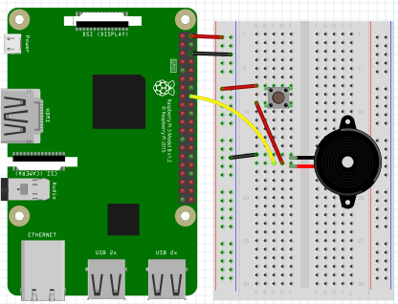
circuit
Notes:
Help them make the circuit

Slide 16
Python setup: we will need these lines of code
GET THE LIBRARY
DEFINE PINMODE
PIN SETUP
INITIALIZING PINS AND DECLARING PINMODES
Is this going to be an OUTPUT or an INPUT pin?

Slide 17
Possible functions
GPIO.setup(pin, Mode)
GPIO.setmode(GPIO.BCM)
MorseCode(pin)
GPIO.cleanup()
input()
print()
.Speak(message)
.upper()
Notes:
Have them write the code using the skeleton code, walk around and help.

Slide 18
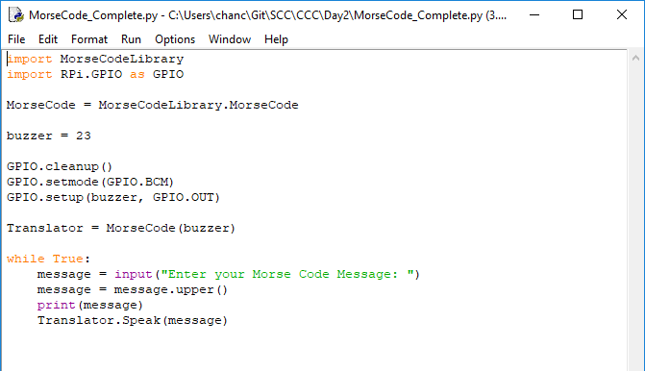
Optimized CODE
Notes:
Run through this with them. Ask about ways to simplify the code.

Slide 19
URL: KAHOOT.IT
Notes:
Day 3: Final Kahoot

